Slide 1
Organic Social Media Strategy Template
Build your organic social media strategy.

Slide 2
Historical Analysis, Insights/Observations, and Recommendations
Review the Fall 2021 Facebook awareness campaign dataset under the Organic tab.
Identify 3 key insights/observations and one improvement for each.
Videos are seem to have more reach, engagement, impressions, and views than photo | I would recommend to post more videos instead of photo .
The product posts are no so effective | Try to make quality content with showing more features about the product
Lifestyle post seems more active | Try to focus on lifestyle posts

Slide 3
Identify your platforms
Based on the provided documents and campaign brief, identify 3 social media platforms you will use to market.
For each platform, explain why and how these platforms support your campaign objectives.
Facebook due to its heavy traffic
Instagram quality content and genuine users
Pinterest as most women uses it
08

Slide 4

Identify your audience
Review the provided persona profile documents, and use those to create 4 customer profiles. Each profile must include 1)title, 2)age, and then 3) three additional key points. (Profile image is optional)
Profile image
(optional)
Profile image
(optional)
Profile image
(optional)
Profile image
(optional)
Marketing manager
Age 25-34
Uses facebook, linkdin, twitter
Communication method email
Goals to start own business
Real estate agent
35-44
Income 120k
Self employed
Education- mostly some college or no education
Web developer
35-44
Education masters
Hobby book collector
Online webinars, meet up
Pharmaceutical sales specialists
45-54
Income 85k
Facebook, linkdin, twitter
Organization size 10001+ employees

Slide 5
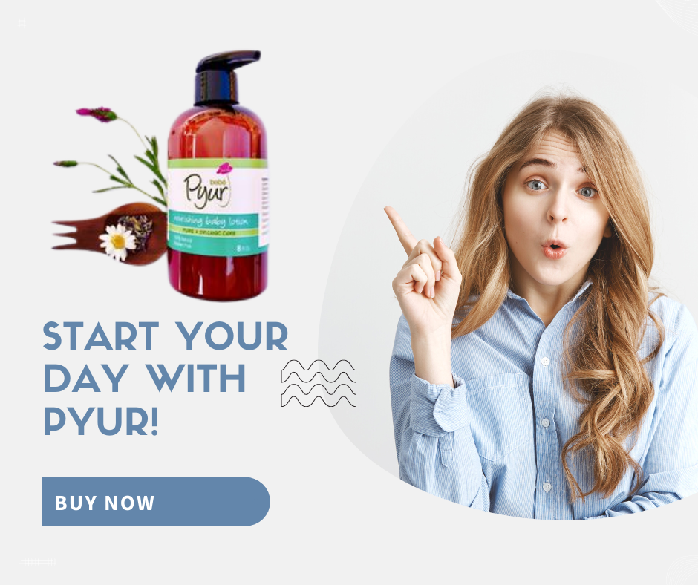
Content Theme Sample Post
Based on the 3 content themes(Core of brand, Calendar, Conversational), choose one and create a mock post. Mock post should include
Type of Content theme
image: should be 1) lifestyle image that represents any of customer profile from the previous slide or 2) product image from the website ).
Copy-text: should be 1-3 sentences about the product including a call to action
Core of the brand
Creative mockup post
Copy-Text /Caption | Start your day with PYUR!

Slide 6
Calendar and Cadence
Please provide a typical week snapshot of your social media posting calendar.
The posting calendar must include at least 4 posts per platform throughout the week.
Each post must include Post Title/Description, Publish Time, Content Theme, Placements
 | elements to include | Sunday | Monday | Tuesday | Wednesday | Thursday | Friday | Saturday
Platform 1 (Facebook) | Post Title/Description Publish Time Content Theme Placements | Five essentials for clean skin 12 p.m. Core of the brand Feed and Stories |  |  | Start your week 10am Feed Core of the brand |  | Product features 9 pm Stories and feed Core of the brand | Which one do you like 2pm Feed Conversional
Platform 2 (Instagram) | Post Title/Description1 Publish Time Content Theme Placements | Start your day 10 am Core of the brand Stories | Start your week 8 am Stories and feed Core of the brand |  |  |  | Give yourself some time 12 pm Core of the brand Stories and feed | Which one do you like 12pm Stories Conversional
Platform 3 (Pinterest) | Post Title/Description Publish Time Content Theme Placements | How to use 4 pm Core of the brand Feed |  | Discount 10am Feed Core of the brand |  |  | Give your self some time 12pm Core of the brand feed | Let’s restock 4pm Feed Core of the brand

Slide 7
New Opportunity/Growth Strategy
Please provide a tactic that will help grow a new channel using newer platforms (i.e. TikTok, Snapchat, Pinterest, etc)
The goal: Provide the who, what, where, and how you will grow the channel.
Who: Target Audience | Male/Women, age 20-30,
Where: Channel | Social media channel like Tiktok, snapchat, Pinterest
What is the tactic? | Creating eye catching lifestyle content(videos/photos) for the product.
How will it grow the channel? | The tactic will grow the channel by attracting young generation who are mostly active on those channels and want to improve their lifestyle.

Slide 8
Paid Social Media Plan
Build your paid social media strategy.

Slide 9
Historical Analysis, Insights/Observations, and Recommendations
Review the Fall 2021 Facebook awareness campaign data and charts under (Paid tab)
Identify 3 key insights/observations and one improvement for each.
Remember, the campaign objective is awareness.
The awareness video has more reach, impressions, and less CPM | Put the budget of image in video it will increase awareness
Facebook has more impression then any other platform | Try to focus on other platform e.g. instagram, pinterest
Awareness testimonials video has 54785 reach and awareness product feature image has only 15780 reach | it means video has more reach then image so try to make more videos

Slide 10
Based on the campaign brief, identify the campaign objective, budget, and which platforms you will run ads on?
Campaign Objective | The objective of the campaign was to build awareness
Budget | $8000 and $2000 for influencers
Platforms | Facebook, instagram, oculus

Slide 11
Who is your target audience and what is the reach for this campaign?
Review buyer personas, and campaign brief to identify target audience demographics, Geo-targeting,and behavioral targeting
Audience Demographics | Audience are mostly aged between 25-34, 45-55, and 34-44
Geo-targeting | by industry and by organization size
Behavioral targeting | Interested in fishing, international travel, book collector, activities with kid, Mostly Uses facebook, twitter, linkdin etc

Slide 12

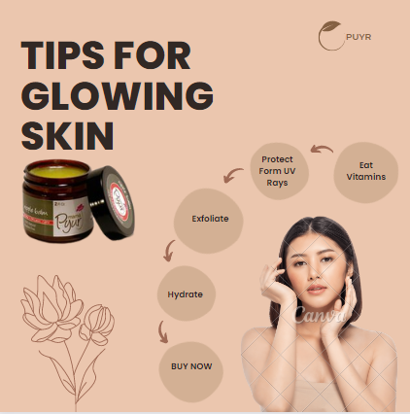
AD MOCKUPS
Based on the campaign objective, create ad mock-ups for a Facebook (Meta) campaign. Please create ads for two placements, one for Facebook (Meta) Stories, and the other for the Facebook (Meta) feed. The ads must include an image that represents the brand, one post text caption, and one call-to-action.
Stories Ad
Feed Ad
Creative mockup post image
Creative mockup post image
Caption Text: Tips for Glowing skin
Call To Action: Send message
Caption Text: Skin care
Call To Action: Buy Now

Slide 13
Facebook A/B Test
Based on the campaign brief and other provided information,complete all sections of the A/B test table below. Some of the budget details are provided for you in the brief, but you will need to identify the A/B test details. Make sure it is clear the difference between A & B. Also complete the Expectation and next steps section.
Facebook A/B Test for Optimization
Name of Ad | Campaign Objective | (Evaluation metrics) Key Performance Indicators (KPIs) | Audience | Budget
Ad 1 | Increase awareness | Impression rate, reach, frequency | Target audience | $2500
Ad 2 | Increase website traffic | Click through rate | Niche audience | $3000
Expectation and next steps: Describe your goal is for the A/B Test and what you next steps will be based on results.
your response here

Slide 14
Influencer Overview
Based on campaign objectives, provide a snapshot overview of the concept
Who/How many: Target audience of influencers | Health care lovers,
Where: Activation Channels | facebook
What: type of lifestyle? | Beauty artist, blogger,
When: will it launch? Duration? | Launch during weekend for 2 weeks
Cost? | $2000
How: What is the project proposal?

